Slide 1

Waleed Afzal 23P-0566 Assignment # 3 - PPT Section # 3D

Slide 2
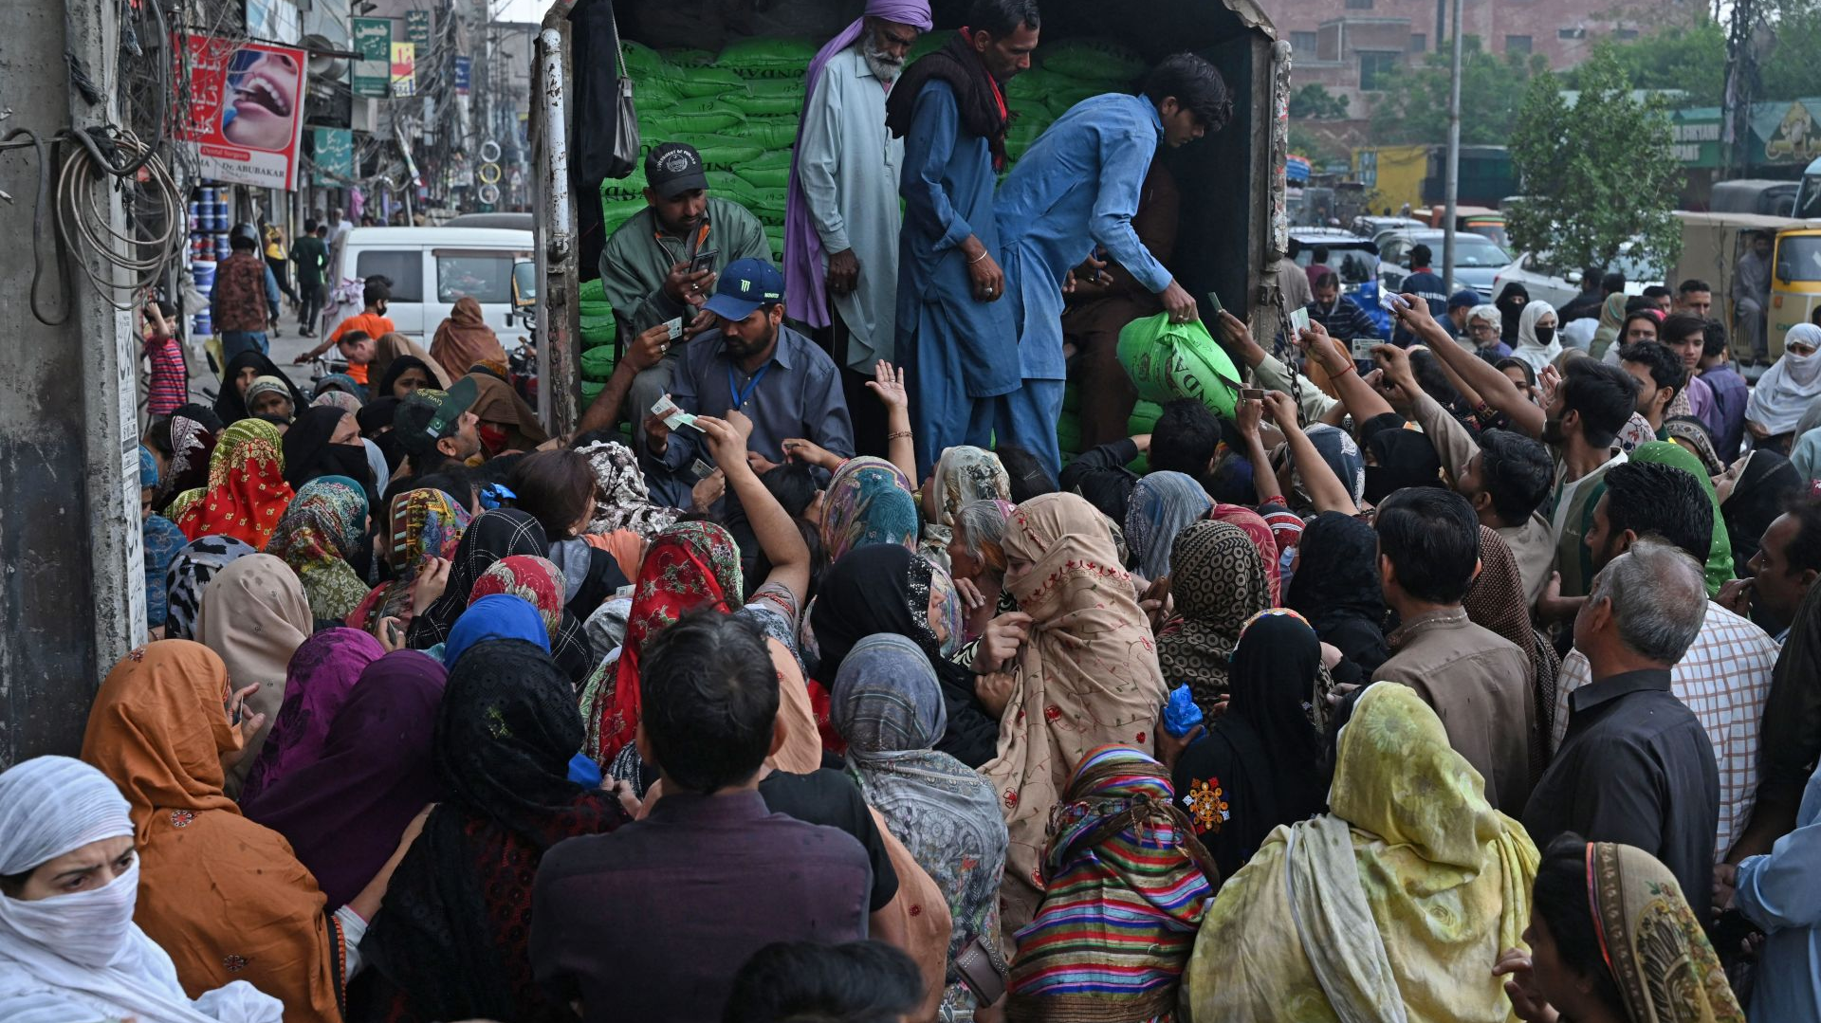
Civil Society, Political Participation, and Democracy in Pakistan
An Overview of Pakistan's Socio-Political Landscape

Slide 3

Civil Society in Pakistan: Role and Sectors
Civil society plays a crucial role in shaping Pakistan's socio-political environment, covering education, health, human rights, and environmental protection.

Slide 4


Historical Contributions of Civil Society
Civil society, including movements like the Lawyers Movement (2007-2009), has been instrumental in advocating for democratic governance and human rights during military regimes.

Slide 5

Challenges Faced by Civil Society
Civil society faces challenges such as restrictive government regulations, limited funding, and security threats, particularly in conflict-prone areas.

Slide 6
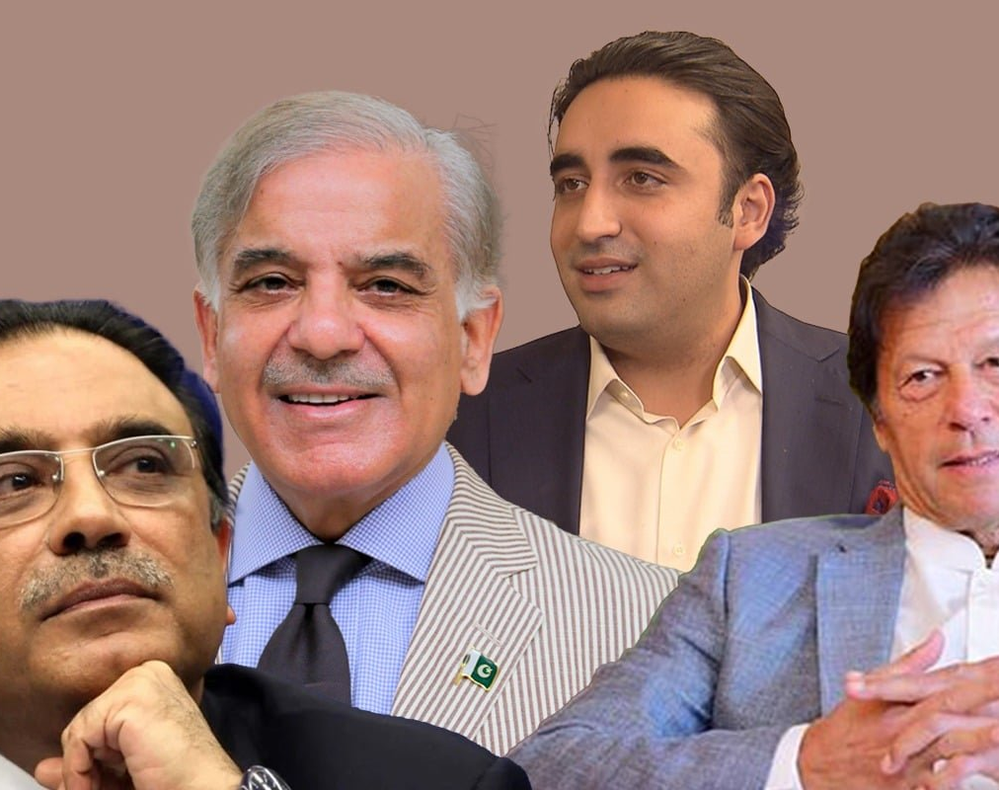
Political Participation in Pakistan: Voter Engagement
Political participation is influenced by socio-economic and cultural factors, with voter turnout at 51.7% in the 2018 general elections.

Slide 7
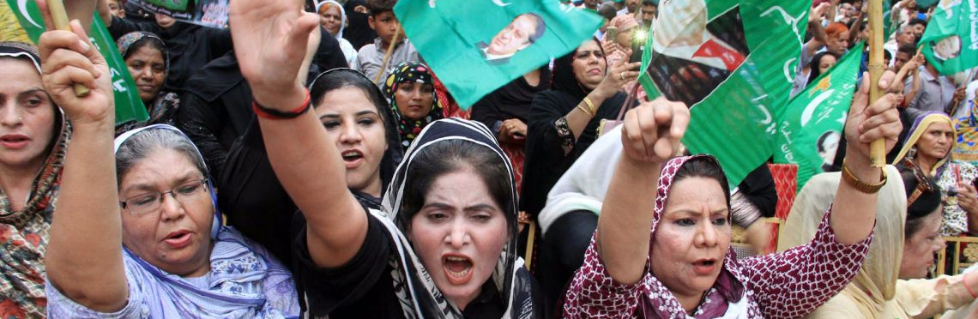
Barriers to Women's Political Participation
Only 40% of registered female voters participated in 2018 due to societal and cultural constraints, highlighting significant gender disparity.

Slide 8
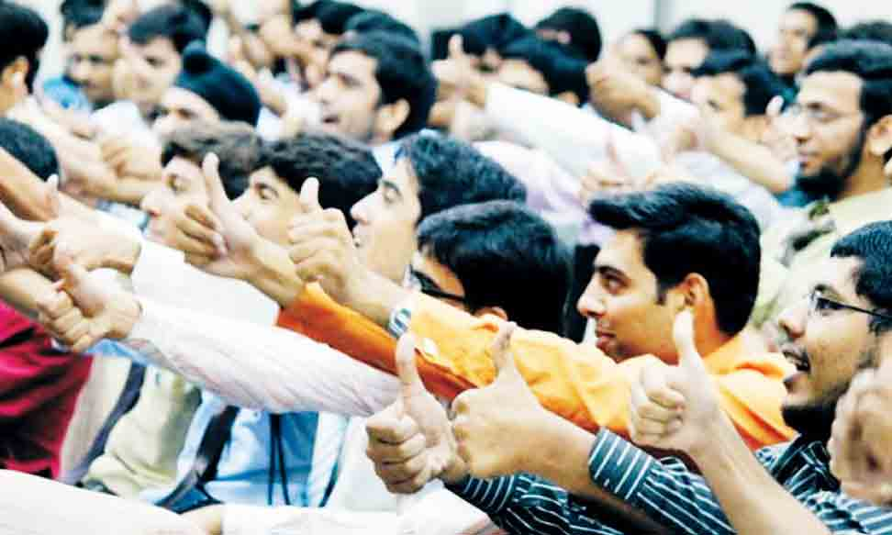
Youth Political Participation in Pakistan
Youth participation has been inconsistent, with only 36% of eligible young voters participating in the 2013 elections. Social media plays a role in mobilization, but its effect on turnout is mixed.

Slide 9
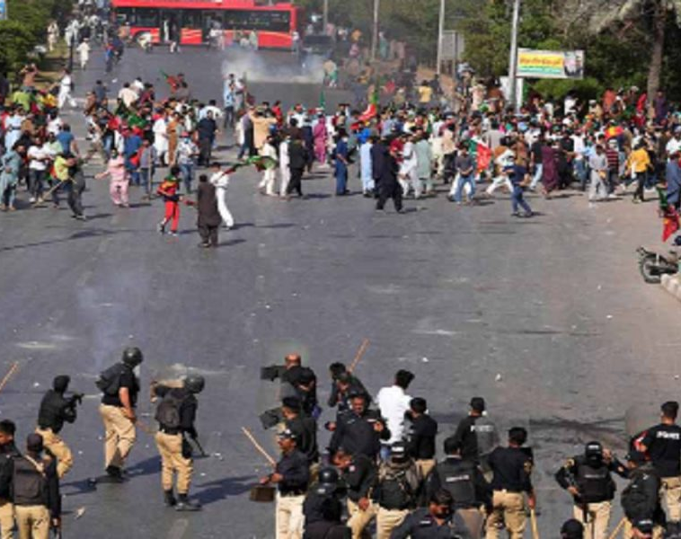
Barriers to Political Participation
Barriers include poverty, lack of education, political violence, and bureaucratic hurdles, which restrict engagement in the political process.

Slide 10
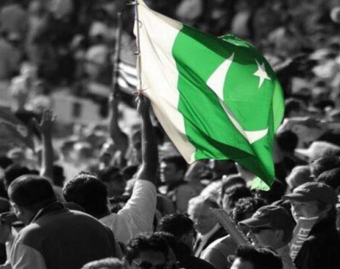
Democracy in Pakistan: Journey and Challenges
Pakistan’s democracy has faced challenges, including military interventions in 1958, 1969, 1977, and 1999. However, the peaceful transition of power in 2013 was a milestone.

Slide 11
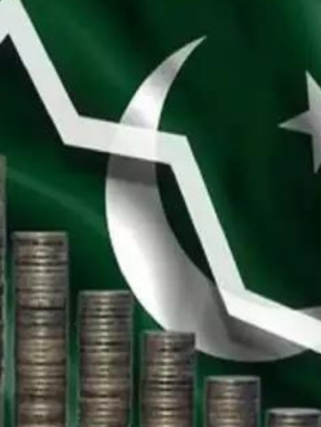
Conclusion: Civil Society, Political Participation, and Democracy
Civil society, political participation, and democracy are deeply intertwined in Pakistan. Despite challenges, these sectors are evolving, shaping the country's future.

Slide 12

References
cfr.org
adb.org
academia.edu
researchgate.net
en.wikipedia.org
thediplomat.com
pakistantoday.com.pk
brookings.edu
freedomhouse.org

